Slide 1






Voting Web Application using Django Framework
Student Details
Name:pandi deepa G
NM Id:au922221104035
College Name: Theni Kammavar Sangam College of Technology

Slide 2

Course Outline
Abstract
Problem Statement
Project Overview
Proposed Solution
Technology used
Modelling & Results
Future enhancements
Conclution

Slide 3

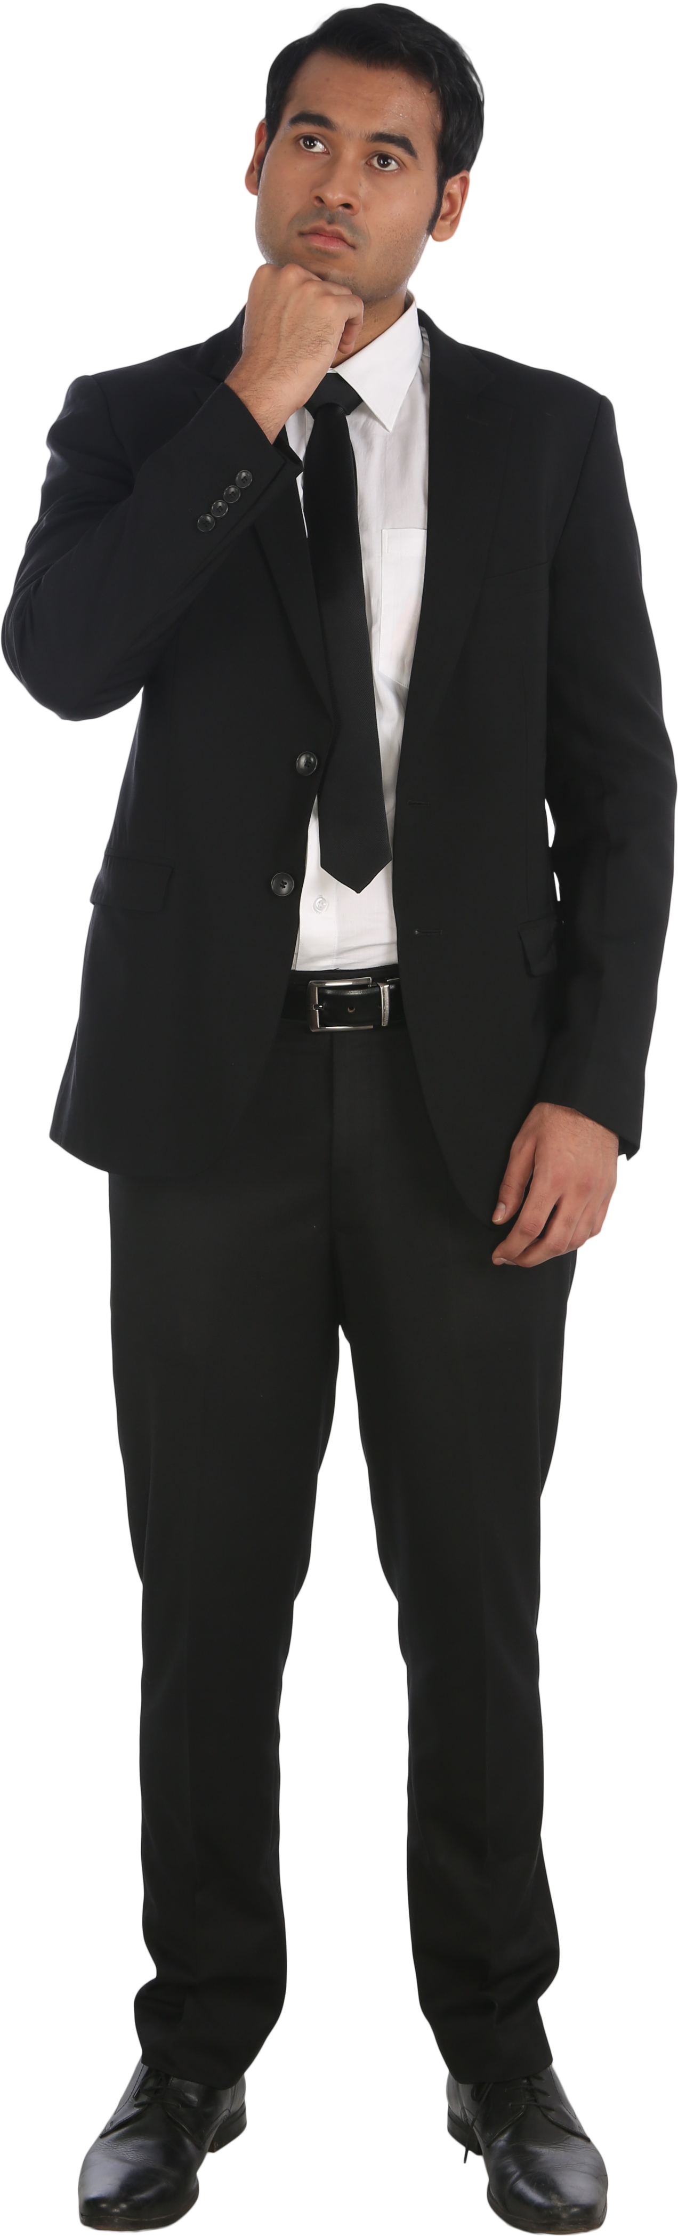
Abstract
Our voting web application provides users with a platform to pose questions and gather opinions through a simple and efficient voting process. Users can submit questions along with three options, and fellow users can cast their votes. This project aims to facilitate democratic decision-making in various contexts, ranging from casual opinion polls to more serious matters.

Slide 4


Problem Statement
Traditional methods of gathering opinions and conducting polls can be cumbersome and time-consuming. There's often a lack of efficient platforms for users to engage in democratic decision-making processes.
Our goal is to address these limitations by developing a user-friendly voting web application.

Slide 5

Project Overview
Our voting app allows users to create questions with three options and enables other users to cast their votes. The platform provides a seamless experience for both posing questions and participating in the voting process. It's designed to be intuitive, engaging, and accessible to a wide range of users.

Slide 6

Proposed Solution
Explain how the voting app addresses the identified problems.
Discuss the features and functionalities that make the app an effective solution.
Highlight any innovative or unique aspects of the proposed solution.

Slide 7

Technology Used
Our voting app is built using modern web development technologies such as HTML, CSS, JavaScript, and a backend framework like Node.js. We utilize a database system such as MongoDB to store user-generated content securely.
List the technologies and tools used in developing the voting app.
Briefly explain why each technology was chosen and its role in the project.
Mention any frameworks or libraries utilized for development.
Notes:
7

Slide 8
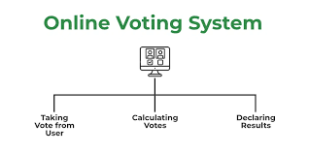
Modelling & Results
Describe the process of designing and modeling the voting app.
Present any data or statistics related to user engagement or voting patterns.
Highlight any successful outcomes or achievements of the project.
Notes:
8

Slide 9
Future Enhancement
Discuss potential future developments or enhancements for the voting app.
Mention any planned features or functionalities that could be added in future iterations.
Address any feedback or suggestions for improvement received during the development process.
Notes:
9

Slide 10
Model Development & Algorithm
Image Preprocessing:
We have used CV2 for digital image processing.
The preprocessing is done in 2 steps,
Grayscalying,
Resizing
Grayscaling is done using cv2.IMREAD_GRAYSCALE function.
Resizing the image to a (256,256) size using cv2.resize(img, function.(256, 256))
Notes:
10

Slide 11
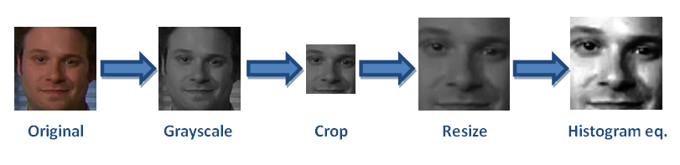
Model Development & Algorithm
Pre-processed Image:
Notes:
11

Slide 12
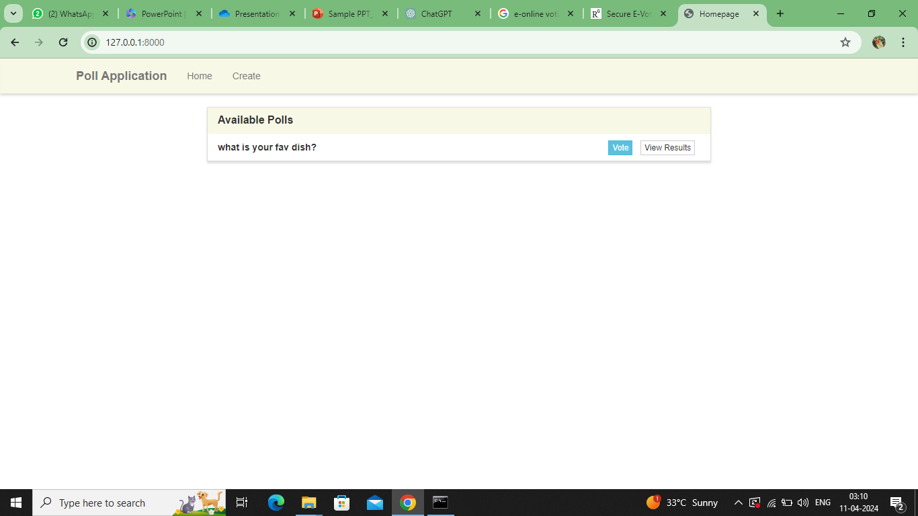
Result -poll application home page
Notes:
12

Slide 13
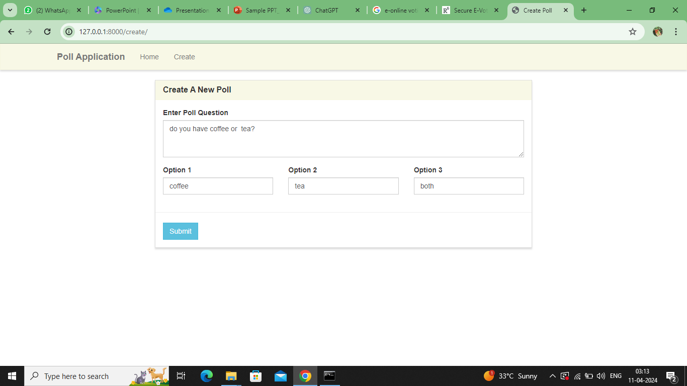
Create
Notes:
13

Slide 14
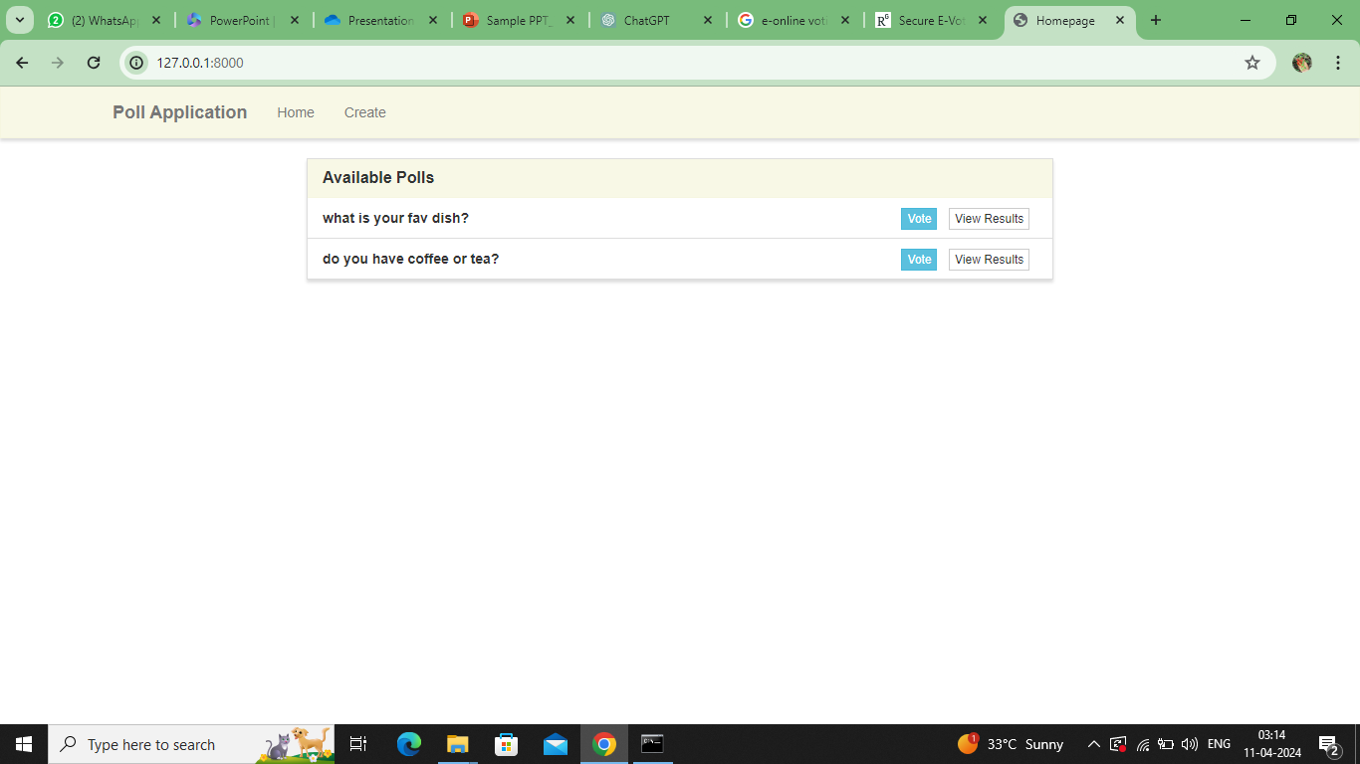
Available polls
Notes:
14

Slide 15
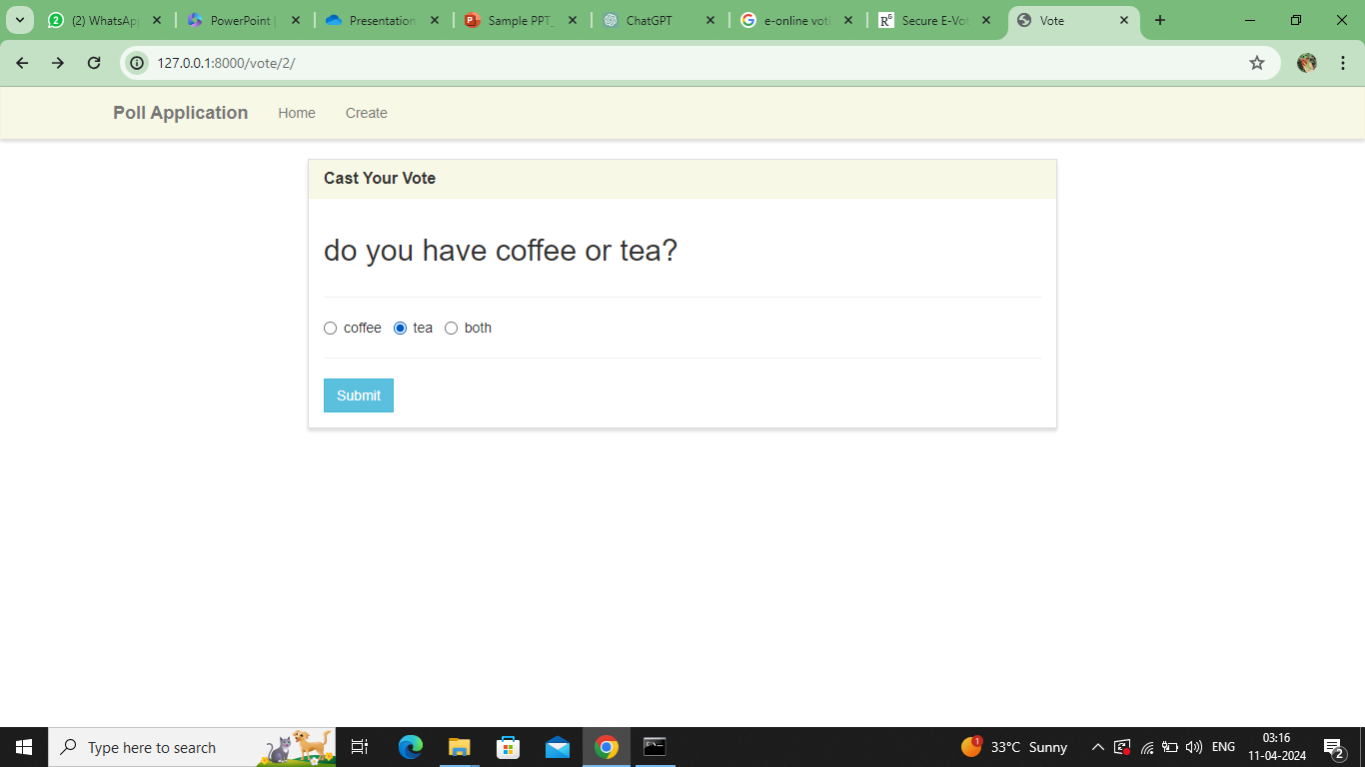
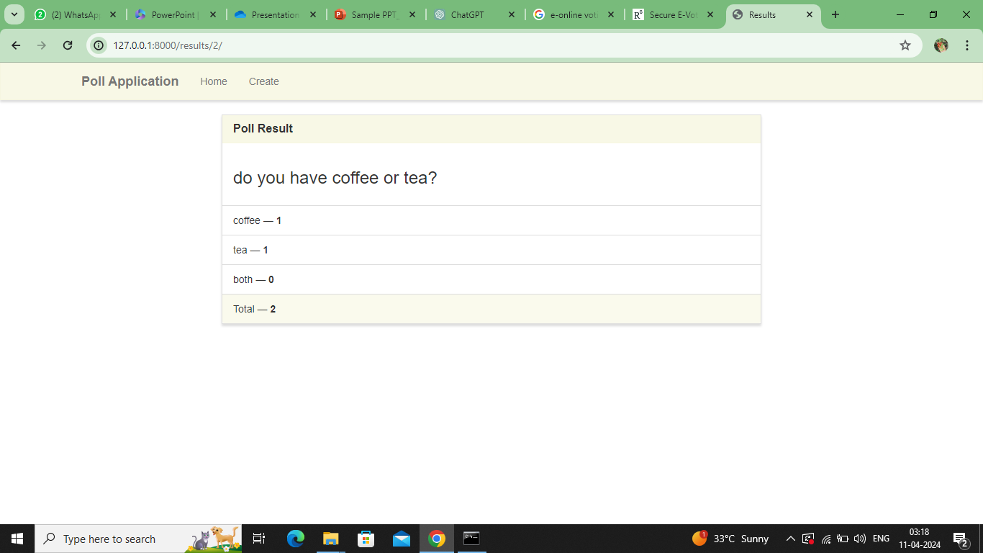
Vote and view result
Notes:
15

Slide 16
Conclution
Summarize the key points discussed in the presentation.
Reinforce the importance of the voting app and its potential impact.
Thank the audience for their attention and invite any questions or feedback.
Notes:
Reference
These are the references for this session.

Slide 17
Thank you!
Notes:
17

